Slide 1
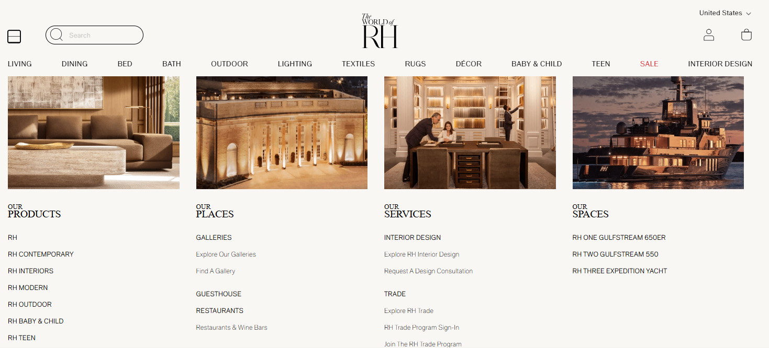
RH – ANOTHER STEP INTO LUXURY
Strategy Partners Group

Slide 2
Core RH Goals
Brand Elevation: “Our strategy is to move the brand beyond curating and selling product to conceptualizing and selling spaces, by building an ecosystem of Products, Places, Services and Spaces that establishes the RH brand as a global thought leader, taste and place maker.”
Global Expansion: ”We believe that our luxury brand positioning and unique aesthetic have strong international appeal, and that pursuit of global expansion will provide RH with a substantial opportunity to build over time a projected $20 to $25 billion global brand in terms of annual revenues.
Products and Product Development: “We are merchants of luxury home furnishings, and our products embody our design aesthetic and reflect inspiration from across the centuries and around the globe.”
Source: RH 10K Feb 3, 2024
Strategy Partners Group

Slide 3


&
BUILDING A GLOBAL LUXURY BRAND…
TOGETHER
Strategy Partners Group

Slide 4

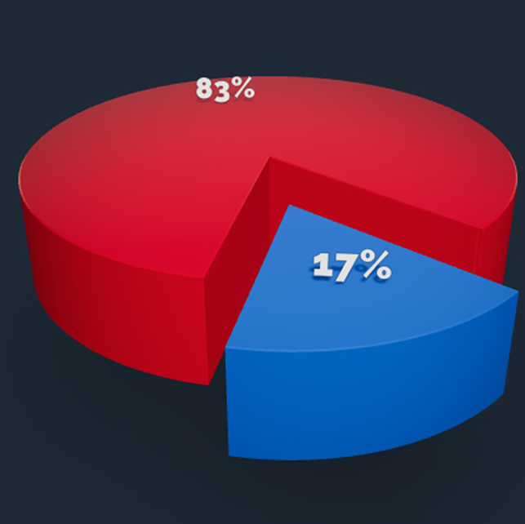
1stDibs 2023 Revenue
Sales on platform / GMV (Gross Merchandise Value): $362 MM
1stDibs Revenue: $85 MM
83% - United States
17% - International
Source: DIBS 10K Feb 29, 2024
Strategy Partners Group

Slide 5
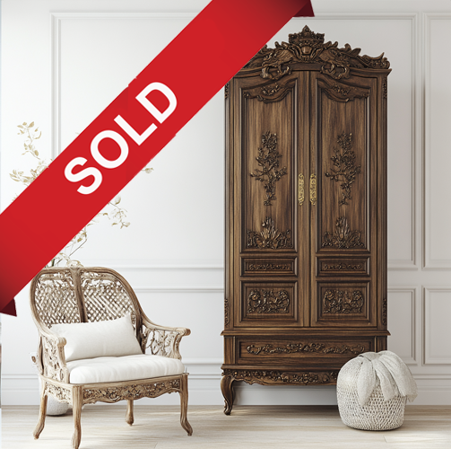
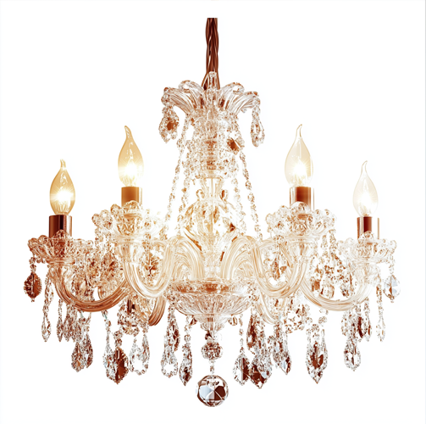
1stDibs 2023 Orders
Orders: 60,000
Average sale: $6,300
20% of GMV from orders with item value $15,000+
5% of GMV from orders with item value $100,000+
Source: DIBS 10K Feb 29, 2024
Strategy Partners Group

Slide 6
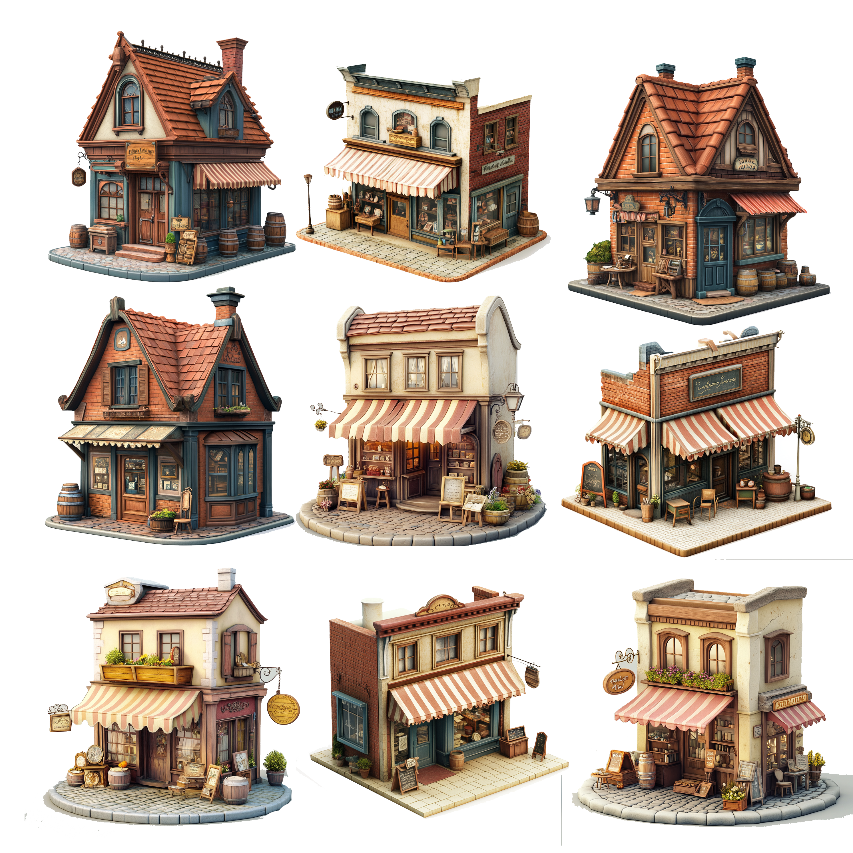
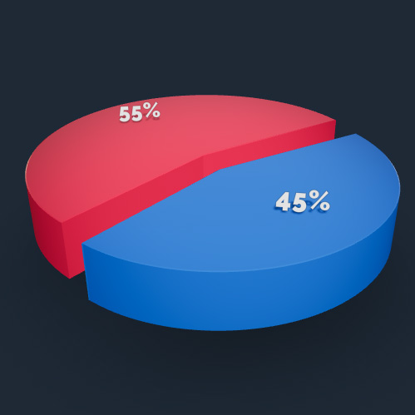
1stDibs 2023 Dealers
7,800 Unique sellers worldwide
55% - United States
45% - International
Source: DIBS 10K Feb 29, 2024
Strategy Partners Group

Slide 7


1stDibs 2023 Users
6.3 Million registered unique users around the world
1.5 Million website visits per month
Source: DIBS 10K Feb 29, 2024
Strategy Partners Group

Slide 8
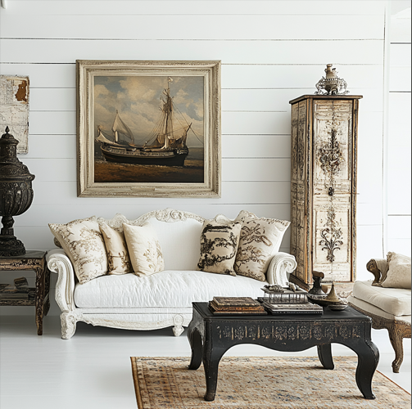
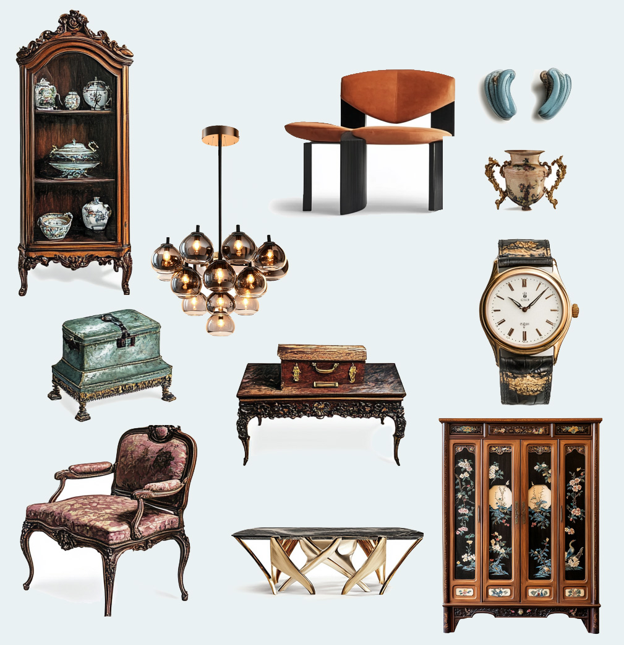
1stDibs 2023 Inventory
1.7 Million listings, 44% from outside the United States
50% - Antique & vintage furniture
50% - New and custom furniture, jewelry, & art
Source: DIBS 10K Feb 29, 2024
Strategy Partners Group

Slide 9

RH Opportunity – Acquire 1stDibs
Acquire 1stDibs for net of $75 MM (Current market cap is $140 MM. 25% premium = $175 MM - less DIBS’ $100 MM cash)
Strategy Partners Group

Slide 10

RH Opportunity – Shipping
Utilize Fernando Garcia’s logistics expertise and RH’s distribution network to address one of the single biggest challenges to driving 1stDibs sales: Shipping.
Strategy Partners Group

Slide 11

RH Opportunity – 1stDibs Database
Leverage 1stDibs’ database to introduce its 6.3 MM worldwide users to RH and build relationships showcasing it and its offerings.
Strategy Partners Group

Slide 12
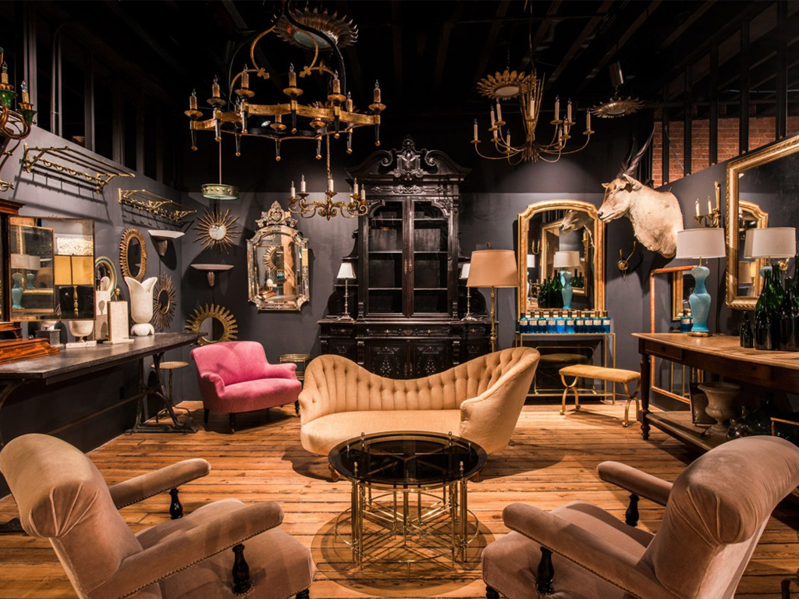
RH Opportunity – 1stDibs in RH
Create showcase pop-up outlets from selected 1stDibs galleries in RH properties, strengthening the notion that RH seeks to fill the needs of buyers across the spectrum, from authentic centuries old antiques to current production to bespoke pieces.
Strategy Partners Group

Slide 13
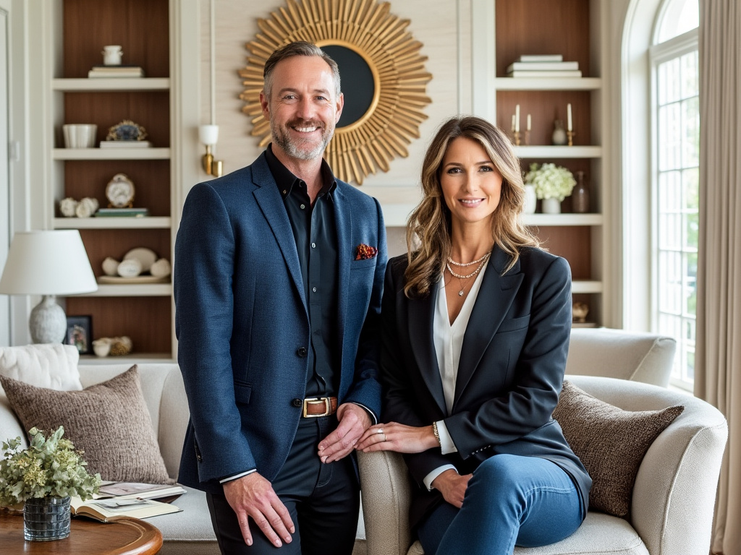
RH Opportunity – Media
Create a program or series of programs for cable / streaming platforms based on designers decorating properties utilizing items from 1stDibs dealers and various RH offerings.
Strategy Partners Group

Slide 14
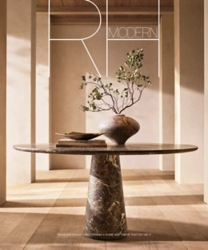
RH Opportunity – Sourcebook
Dedicate pages in the RH Sourcebook for various 1stDibs dealers who help reinforce the RH brand as the global leader in taste, luxury and style, unconstrained by time.
Strategy Partners Group

Slide 15
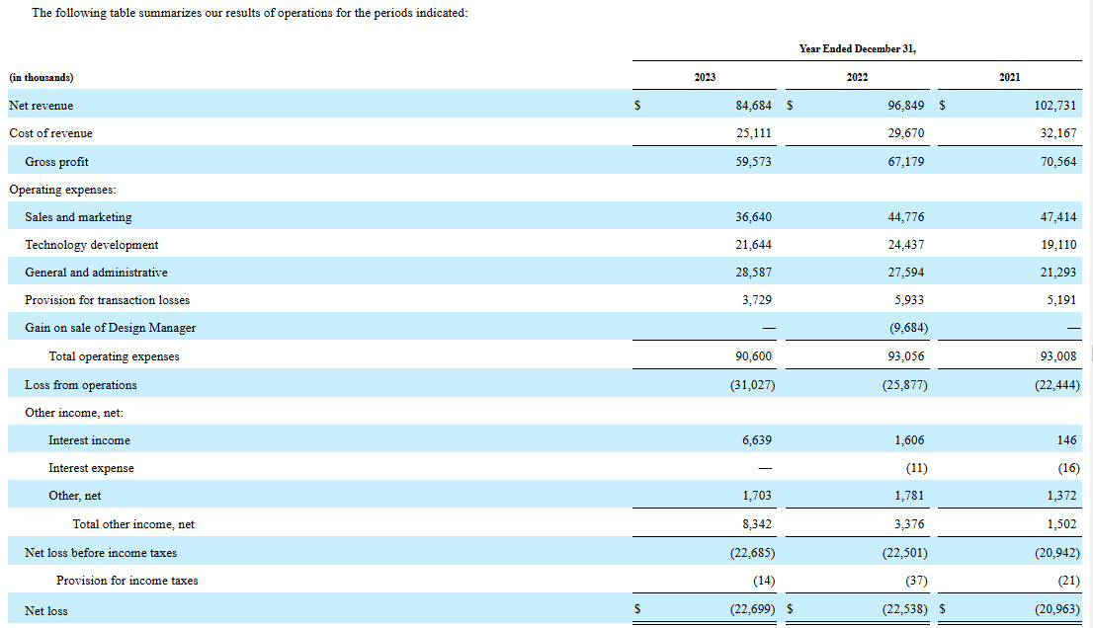
1stDibs 2023 Income Statement
Strategy Partners Group

Slide 16
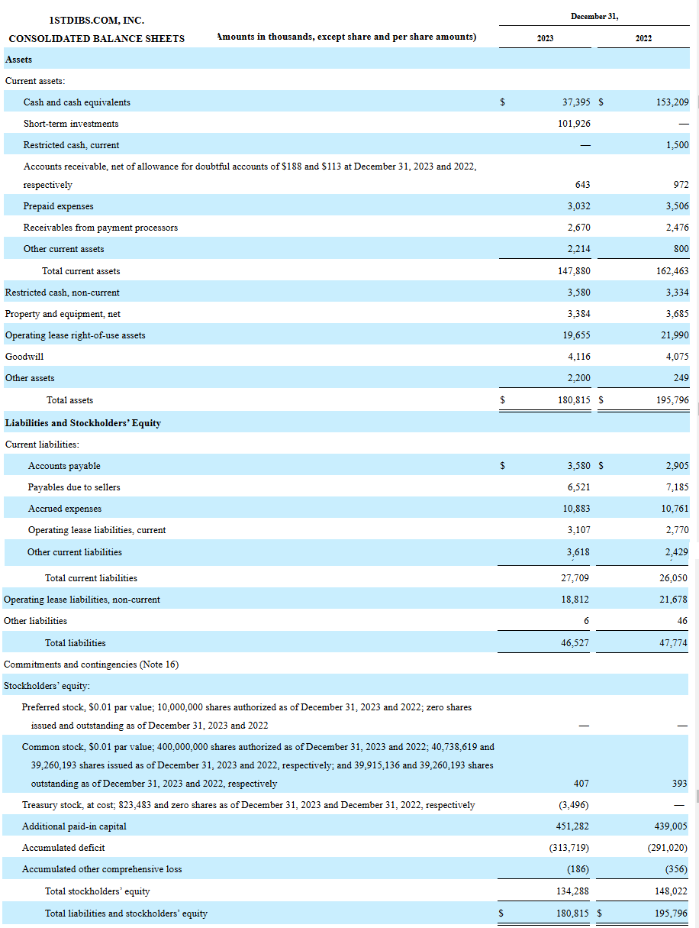
1stDibs 2023 Balance Sheet
Strategy Partners Group

Slide 17
&
BUILDING A GLOBAL LUXURY BRAND…
TOGETHER
Strategy Partners Group

Slide 18
Strategy Partners Group
www.StrategyPartnersGroup.com
Vince Coyner
vince@StrategyPartnersGroup.com
Strategy Partners Group

